Slide 1
Early Detection of Sepsis through Machine Learning
Submitted
By
ABINESH R L (1907003)
MOHAMED ABDUL MAJEED (1907029)
RAGAVEE S V (1907035)

Slide 2
Aim
The primary aim of our project is to detect the occurrence of sepsis in an individual as early as possible through a machine learning model

Slide 3
What is Sepsis?
Sepsis is a disease which develops when the chemicals the immune system releases into the bloodstream to fight for an infection cause inflammatory throughout the entire body instead.
Sepsis is a life-threatening medical emergency. It is sometimes called as Septicemia.
More than 1 million cases are reported only in India for this disease

Slide 4
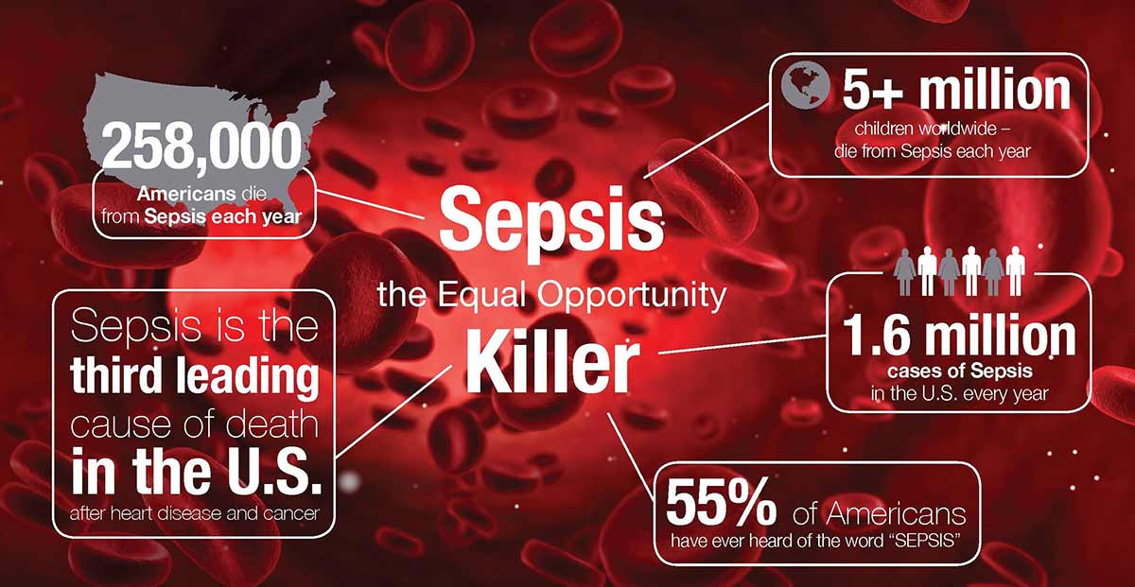
About Sepsis

Slide 5
We inspired to work on this project by TEDx talk show on the topic “BETTER MEDICINE THROUGH MACHINE LEARNING” , by Suchi Saria of Johns Hopkins University.
https://www.youtube.com/watch?v=Nj2YSLPn6OY
In that talk show Suchi Saria shares story of Mrs.Manny a 52year old lady who died of sepsis due to late detection of sepsis and how machine learning
Techniques can help in early detection of sepsis.

Slide 6
Objectives
Goal of the analysis is the early detection of sepsis using physiological data.
The early detection of sepsis is potentially life-saving, and we aim to predict sepsis earlier before the clinical diagnosis of sepsis.
By finding sepsis in non-sepsis patients or detecting sepsis very early in sepsis patients consumes limited resources and we can assume the risk of diagnosis to be minimal but revolutionary.

Slide 7
Clinical criteria
Hypotension
Lactate> 1mmol/L
Mottled skin
Decreased capillary refills of nail and skin
Fever > 36.3 degree Celsius
Hypothermia
Heart rate>90 beats per minute
Tachypnea
Change in metal status

Slide 8
Significant edema
Hyperglycemia
Abnormal WBC count with 10% bands
Elevated C reactive protein in serum
Elevated prolactin in serum
Arterial hypoxemia( paO2/FiO2<300)
acute drop of urine output
Creatinine >0.5 mg/dl
INR >1.5
Absent bowel sound
Platelet count<100,000
High bilirubin(total bilirubin > 4mg/dl)

Slide 9
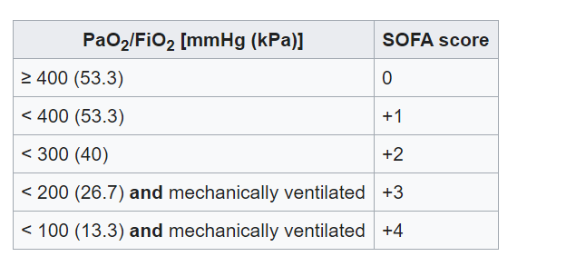
SOFA score
Respiratory System

Slide 10
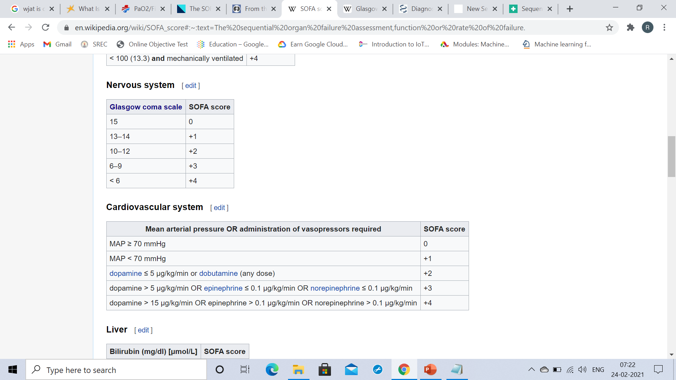
Nervous system
Cardiovascular system

Slide 11
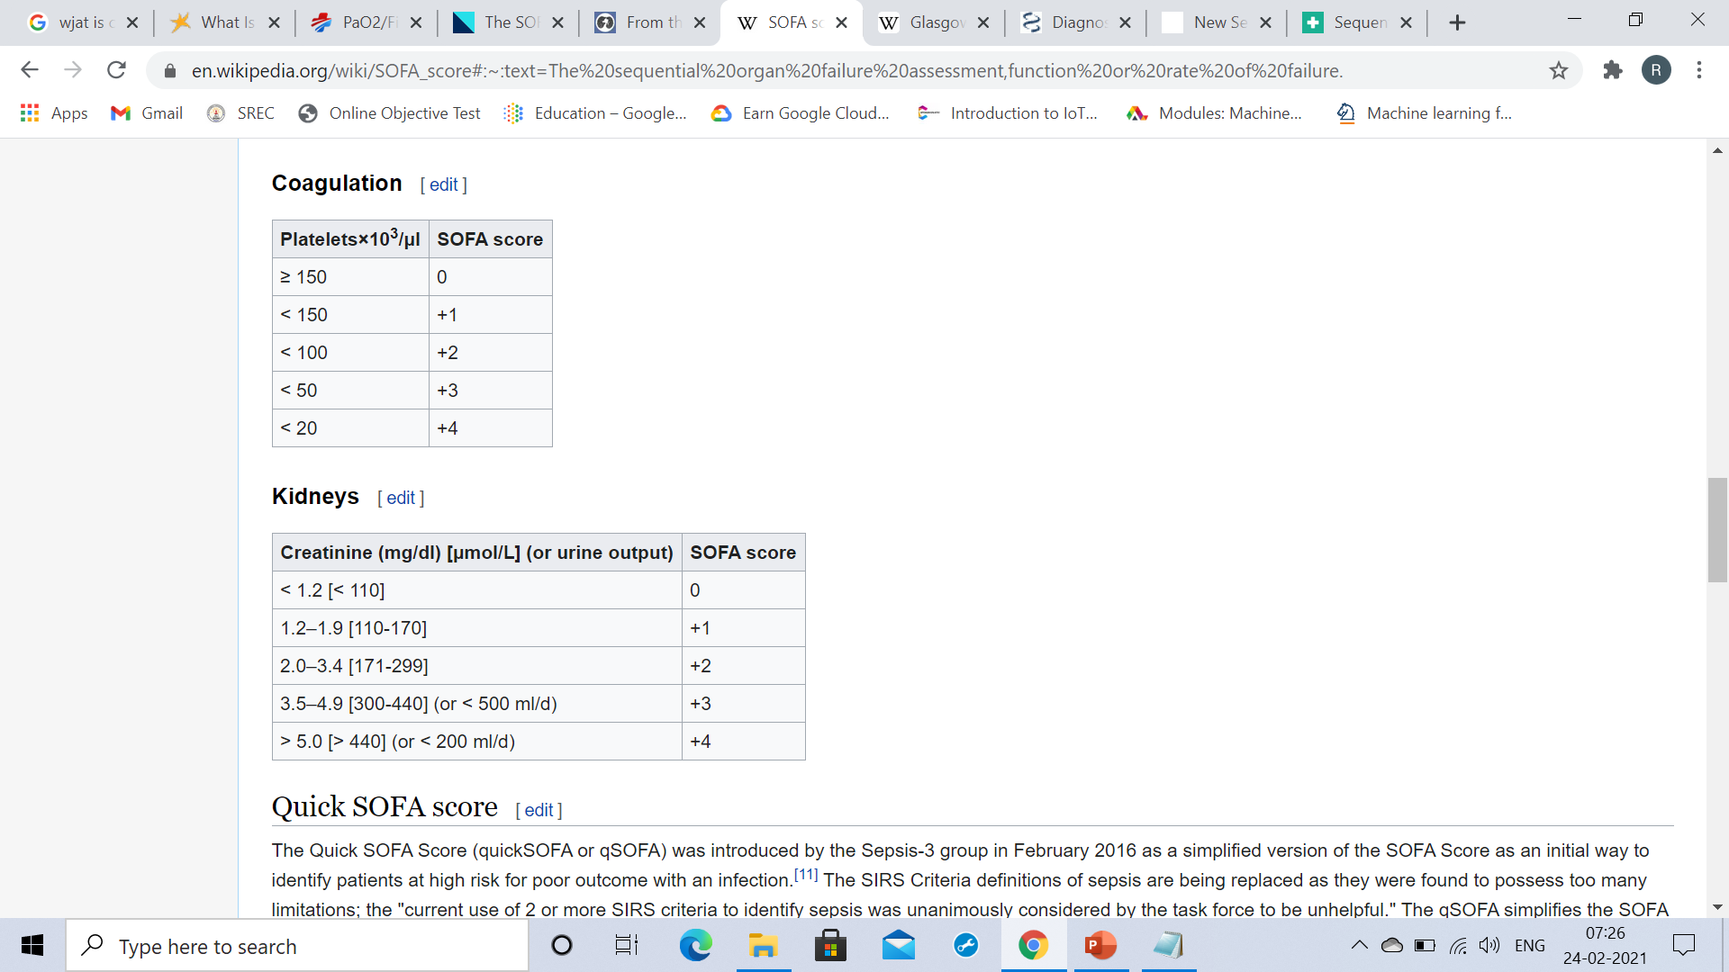
Coagulation
Kidneys

Slide 12
Scope:
This approach uses machine learning technique for the early detection of sepsis.
Further research can be done on developing RNN based classifiers to accurately early predict the onset of sepsis
This project can be targeted toward patients who have been undergone surgery in their recent times.
It is targeted towards hospitals in remote areas where they lack trained technicians.

Slide 13
Why early detection?
Sepsis can be difficult to diagnose because it occurs quickly and can be confused with other conditions. Watch for a combination of the following symptoms.
S Shivering, fever, or very cold E Extreme pain or general discomfort (“worst ever”) P Pale or discolored skin S Sleepy, difficult to rouse, confused I “I feel like I might die!” S Short of breath

Slide 14
Datasets
Dataset we used in this project is sourced from ICU patients in two separate hospitals and it is downloaded from Physionet.
The data will be split into 70% Training and 30 % testing set. The training set will be split for validating the training set.
Each file will have the same header and each row will represent a single hour's worth of data. Each hospital have 20,000 patients and hence 20,000 files.

Slide 15
Methods
Combine all Data
Choosing non-time dependent approach
Handling Missing values
Feature Engineering
Handling Data Imbalance
Baseline Prediction

Slide 16
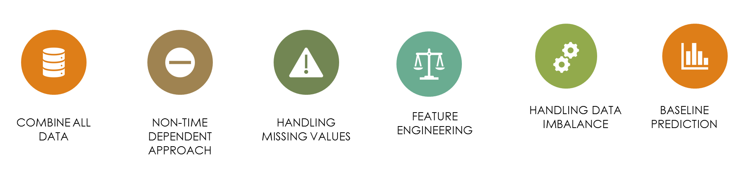
Phase plan

Slide 17
Combining All Data
We need to combine all the data by appending all the patient files.
Features:
Vital Signs : Heart Rate, Temperature, Blood Pressure etc.
Laboratory Values : Glucose, Calcium, Fibrinogen etc
Demographics : Age, Gender, time in ICU etc
Labels : non-Sepsis[0] & Sepsis[1]

Slide 18
Choosing Non time Dependent Approach
There are 2 approaches to choose
Time dependent
Non time dependent
We are going to use non time dependent approach here. Because we can able to detect the sepsis earlier with out depending on past patient record. This will make it Robust and needs less resource.

Slide 19
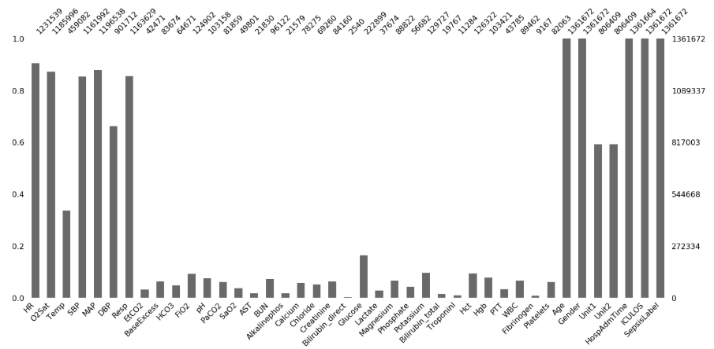
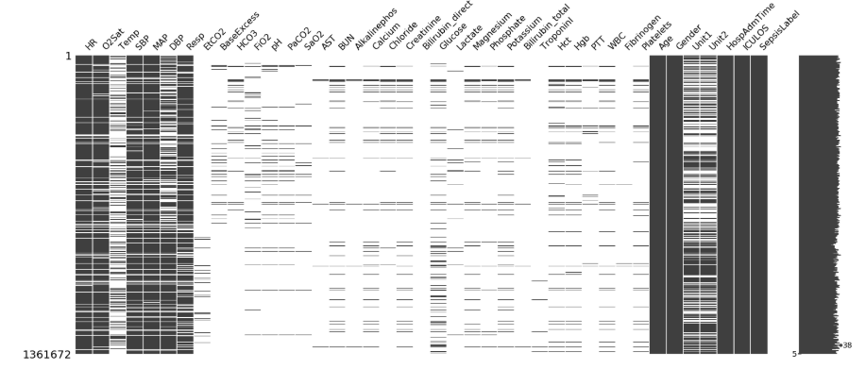
Handling Missing Values
Most of the laboratory values contain missing values.
There are two ways to handle with missing data.
1) Remove features with missing values >90%
2) Categorically encode features to handle missing values.

Slide 20
Feature Engineering
In this part we will select the features needed for the training dataset.
We will select Heart rate, Pulse Oximetry, Body temperature, Blood Pressure (SBP, DBP), Mean Arterial Pressure, Respiration rate, Fraction of inspired oxygen, Age, Gender, Hospital Admission Time and ICU length of stay as the features.

Slide 21
Since this correlation of features contributes a lot to the presence of Sepsis.
Also we are going to create new features like new_age, new_temp, new_o2sat etc from the old features.
This approach makes us to encode the features easiler for the Base line prediction.

Slide 22
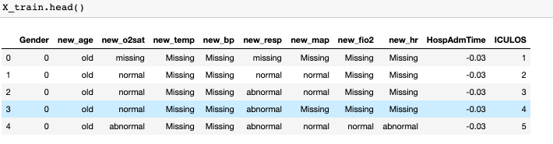
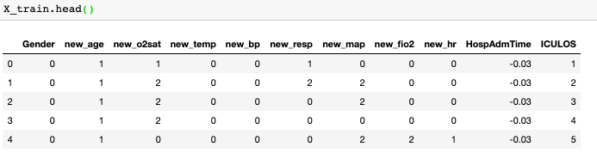
Label Encoding
We also need to encode some features to numbers so we can make it easier to use in machine learning.

Slide 23
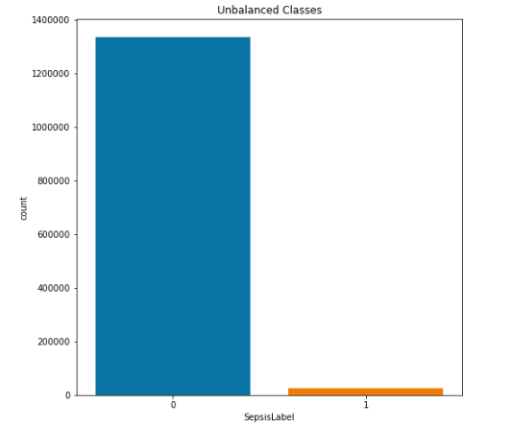
Handling Data Imbalance
In the dataset about 98% people don’t have sepsis and only 2% people have sepsis. This condition is called as Data Imbalance.
There are lot of ways to handle this problem which includes Oversampling, Under sampling, Balance Bagging Classifier, using suitable Algorithm and so on.
Using any of these method we can handle this problem.

Slide 24
Baseline Prediction
We used machine learning ensemble technique random forest and logistic regression for this prediction.
Both the algorithms performs very well and has an accuracy score of above 0.97.
Using this model one can easily detect the onset of sepsis with an accuracy score.

Slide 25
Expected outcome:
Even though data contains majority of values missing we can able to develop an approach which can be used for early detection of sepsis.
The model will detect the onset of sepsis for both the patients with proper EHR as well as with out proper Health Record.

Slide 26
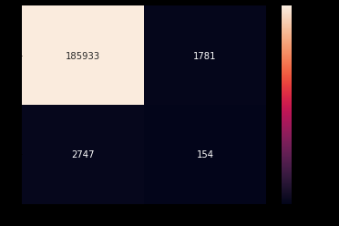

Results (Confusion matrix)
Random Forest
Logistic Regression
testing accuracy: 0.9762453112294416
testing accuracy: 0.9828292631744616

Slide 27
Conclusion
Our project will detect sepsis in patients using less number of features with great accuracy and precision.
If we use Time dependent approach we can predict the onset of sepsis a prior before the diagnosis.
In future this project can be improved by using Deep learning neural networks like LSTM to predict the onset of sepsis with more accuracy.

Slide 28
Acknowledge
We are highly indebted to Dr.V.Mahendran for his guidance and his constant supervision as well as for providing necessary information regarding the project & also for his support .

Slide 29
References
https://www.physionet.org/content/challenge-2019/1.0.0/
https://youto.be/Nj2YSLPn6OY
https://www.datacamp.com/community/tutorials/decision-tree-classification-python
https://curi.com/news/sepsis-case-study
https://towardsdatascience.com/early-detection-of-sepsis-using-physiological-data-78d5f31fab9d
http://www.erogol.com/fighting-class-unbalance-supervised-ml-problem/
https://www.stackoverflow.com
https://vidandiagnostics.com/2017/06/30/sepsis

Slide 30
Thank You!

